Slide 1
2-wheeler-Basic-EV-model-on-Simulink
By Vansh K Goel
By Vansh K Goel

Slide 2
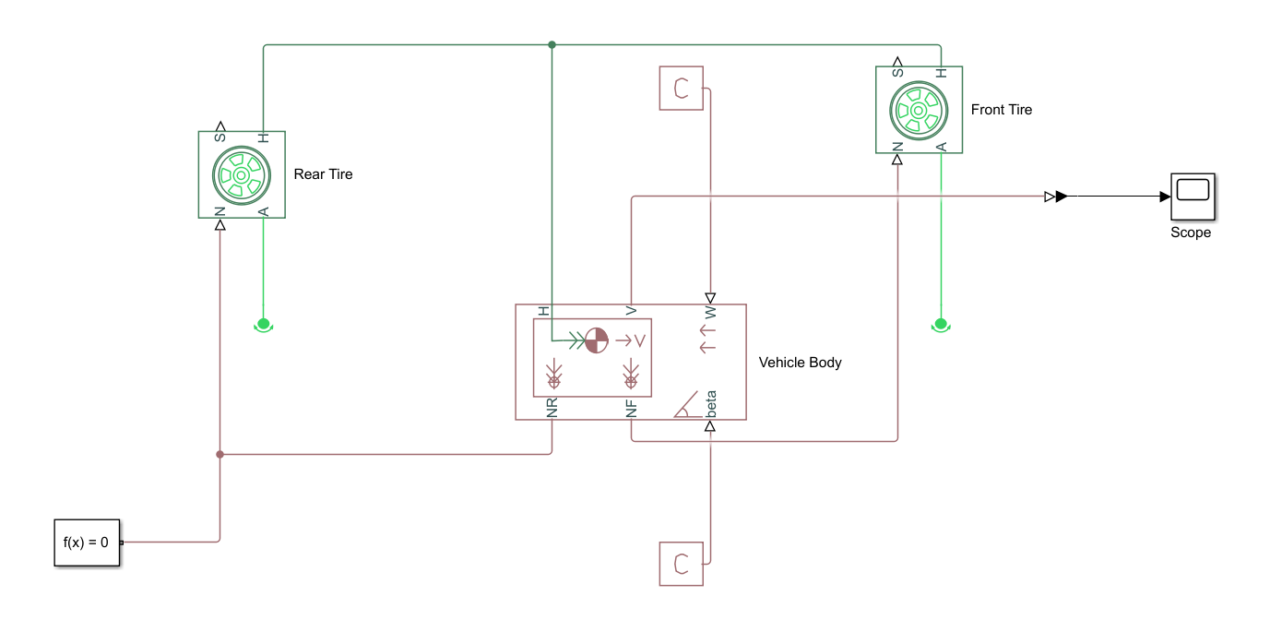
Copmelete Simulink Block Diagram

Slide 3
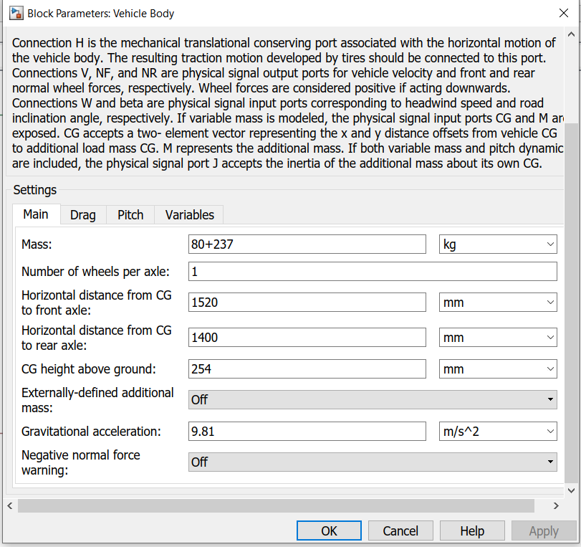
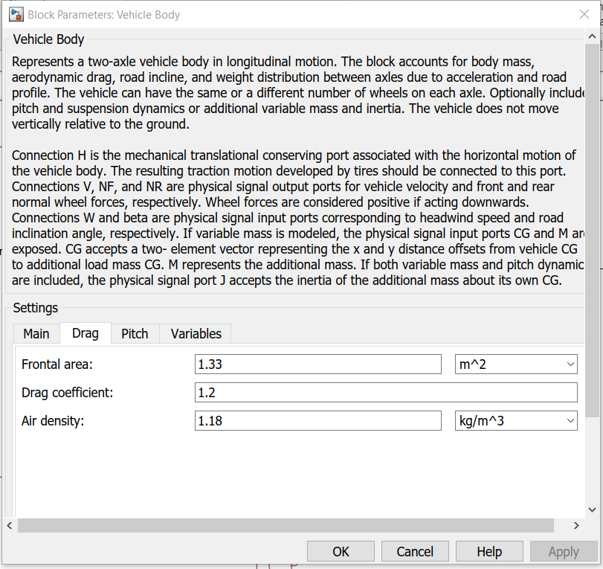
Various Inputs Taken(Vehicle Body)

Slide 4
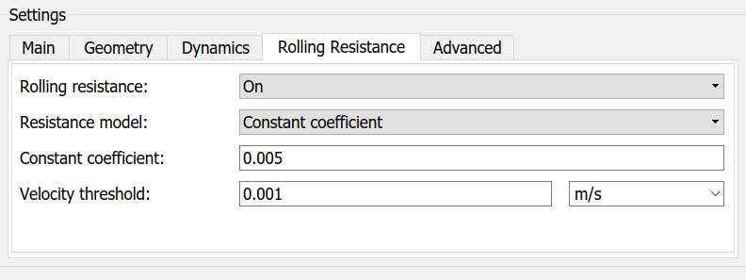
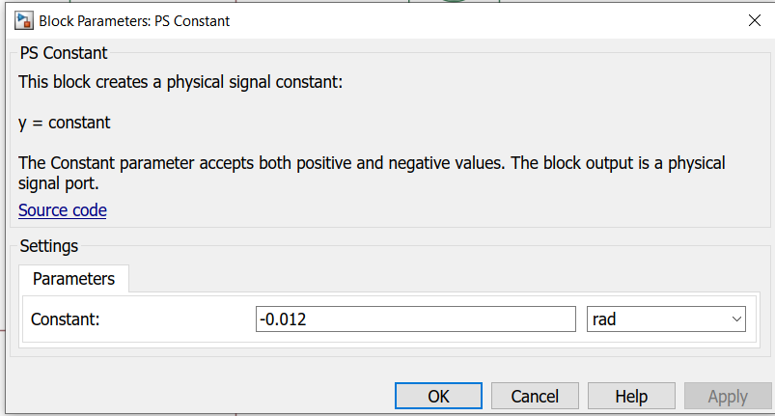
Various Inputs Taken(Tire and Inclination )

Slide 5
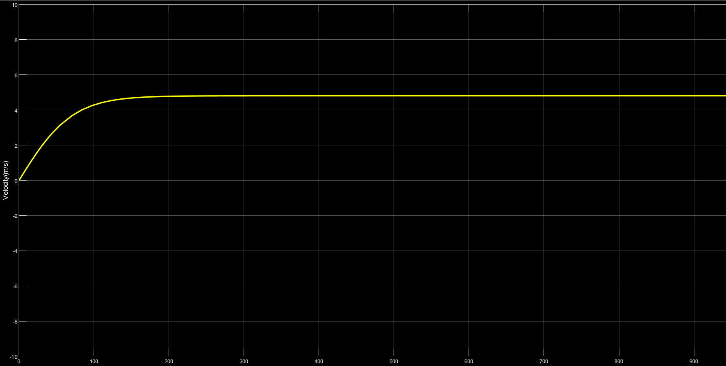
Final Output

